Slide 1

ON-LINE ANALYTICAL PROCESSING
Dr. Yashvardhan Sharma
Department of Computer Science & Information Systems
BITS, Pilani
L11

Slide 2
Dimensional Analysis

Slide 4
Hypercubes

Slide 6
In the figure, note the three straight lines, two of which represent the two business dimensions and the third, the metrics. You can independently move up or down along the straight lines.
Some experts refer to this representation of a multidimension as a multidimensional domain structure (MDS).

Slide 11
Drill down: It refers to the process of viewing data at a level of increased detail
Roll up: It refers to the process of viewing data with decreasing detail

Slide 12
Example of roll-up

Slide 13
OLAP Operations
Roll up (drill-up): summarize data
by climbing up hierarchy or by dimension reduction
Drill down (roll down): reverse of roll-up
from higher level summary to lower level summary or detailed data, or introducing new dimensions
Slice and dice:
project and select
Pivot (rotate):
reorient the cube, visualization, 3D to series of 2D planes.
Other operations
drill across: involving (across) more than one fact table
drill through: through the bottom level of the cube to its back-end relational tables (using SQL)

Slide 14
Rollup & Drill-down
OLAP permit users to view data at ay desired level of granularity.
Rollup: moving from finer-granularity data to coarser granularity
Drill-down: opposite to Rollup

Slide 15
Slice-and-Dice or Rotation
Slice n dice: It is an ability to move between different combinations of dimensions when viewing data with an OLAP browser

Slide 16
Slicing & Dicing
Additional Functionality that can be thought of as viewing a slice of the data cube, particularly when values for multiple dimensions are fixed.
Slicing/Dicing simply consists of selecting specific values for these attributes, which are then displayed on top of the cross-tab

Slide 17
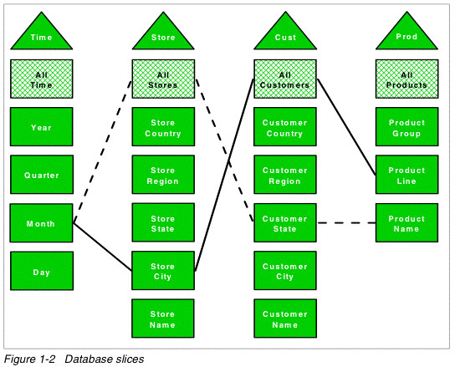

Slide 18
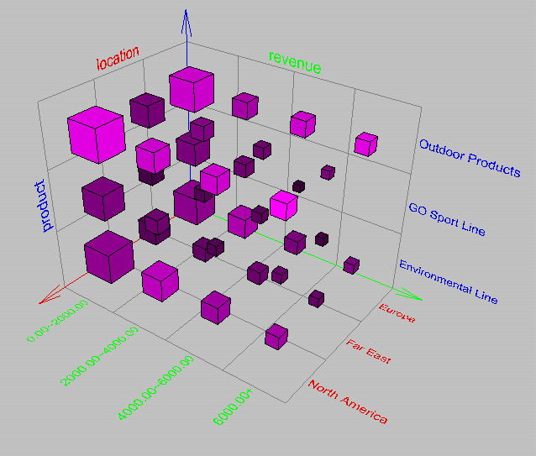
Browsing a Data Cube

Slide 19
OLAP Operation
So, how are concept hierarchies useful in OLAP?
In the multidimensional model, data are organized into multiple dimensions,
And each dimension contains multiple levels of abstraction defined by concept hierarchies

Slide 20
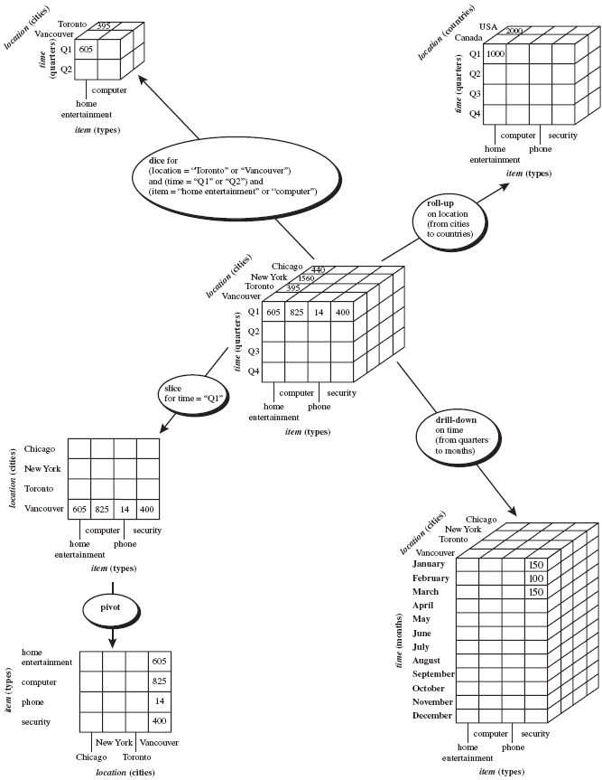

Slide 21
Typical OLAP Operations
Roll up (drill-up): summarize data
by climbing up hierarchy or by dimension reduction
Drill down (roll down): reverse of roll-up
from higher level summary to lower level summary or detailed data, or introducing new dimensions

Slide 22
Typical OLAP Operations
Slice and dice: project and select
Pivot (rotate):
reorient the cube, visualization, 3D to series of 2D planes

Slide 23
Multidimensional Data
Sales Volume as a function of time, city and product
NY
LA
SF
Juice
Cola
Milk
Cream
10
47
30
12
3/1 3/2 3/3 3/4
Date

Slide 24
Operations in Multidimensional Data Model
Aggregation (roll-up)
dimension reduction: e.g., total sales by city
summarization over aggregate hierarchy: e.g., total sales by city and year -> total sales by region and by year
Selection (slice) defines a subcube
e.g., sales where city = Palo Alto and date = 1/15/96
Navigation to detailed data (drill-down)
e.g., (sales - expense) by city, top 3% of cities by average income
Visualization Operations (e.g., Pivot)

Slide 25
A Visual Operation: Pivot (Rotate)
NY
LA
SF
Month
Juice
Cola
Milk
Cream
10
Region
47
30
12
Product
3/1 3/2 3/3 3/4
Date

Slide 26
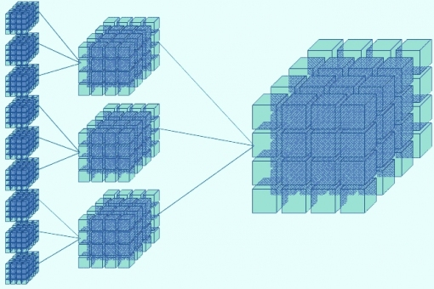
Roll-up: (Aggregate, Consolidate) A roll-up involves computing all of the data relationships for one or more dimensions. To do this, a computational relationship or formula might be defined.

Slide 27
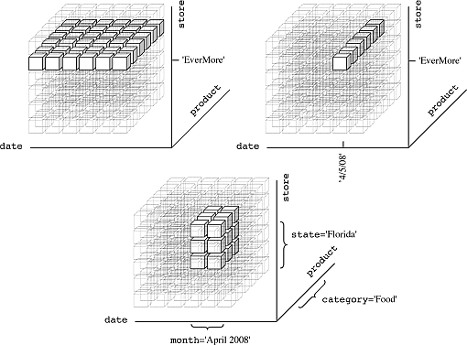
Drill Down: Drilling down is a specific analytical technique whereby the user navigates among levels of data ranging from the most summarized (up) to the most detailed (down).

Slide 28
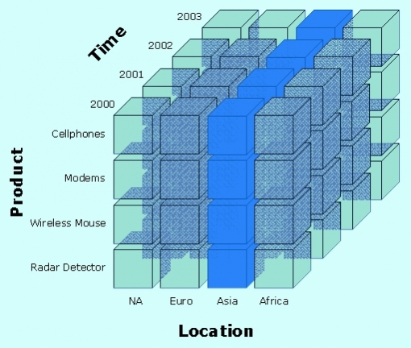
Slice: A slice is a subset of a multi-dimensional array corresponding to a single value for one or more members of the dimensions not in the subset.

Slide 29
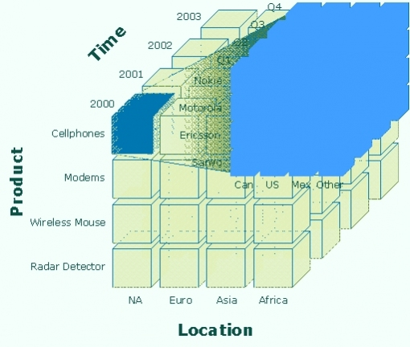
Dice: The dice operation is a slice on more than two dimensions of a data cube (or more than two consecutive slices).

Slide 30
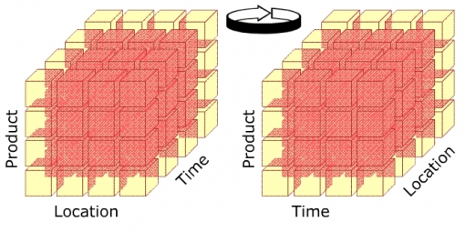
Pivot:This operation is also called rotate operation. It rotates the data in order to provide an alternative presentation of data – the report or page display takes a different dimensional orientation.

Slide 31
Uses and Benefits
Increased productivity of business managers, analysts, and executives
Faster delivery of applications by IT people
Self sufficiency of users, resulting in reduction in backlog
More efficient operation through reducing time on query executions and in net work traffic
Ability to model real world challenges with business metrics and dimensions

